Slide 1


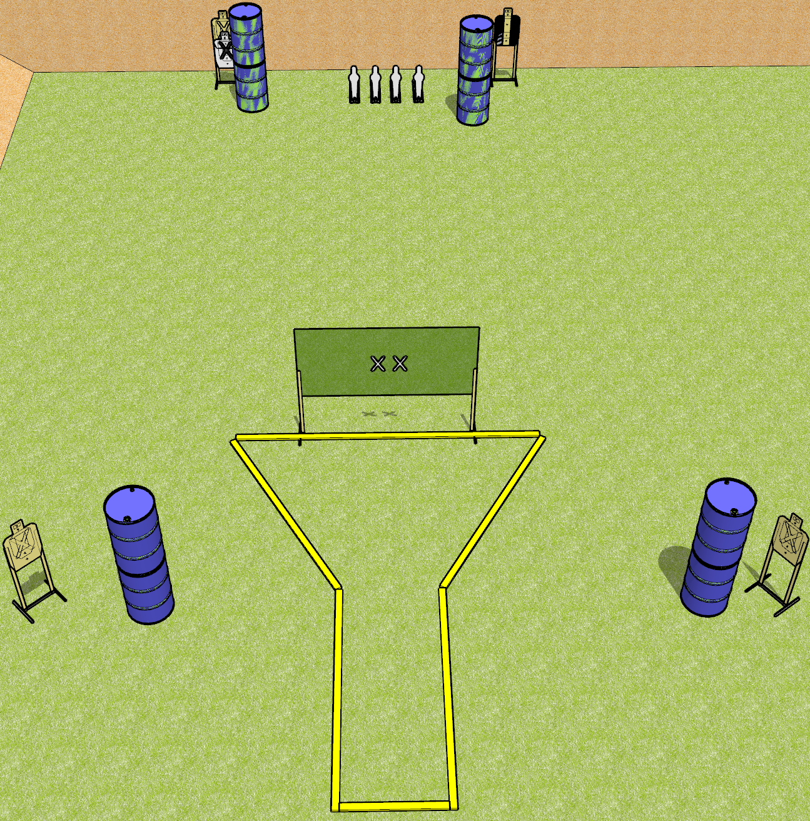
 | Dothan Gun Club – USPSA Match Beaker Course Designer : Drew Coleman
START POSITION : Hands touching both X’s. PCC muzzle touching either X
GUN READY CONDITION : Pistol has loaded magazine inserted with an empty chamber, hammer down. PCC has loaded magazine inserted with an empty chamber, safety on, shouldered, held with box hands, muzzle touching either X. |  | SCORING: Comstock, 12 rounds TARGETS: 4 paper, 4 Steel SCORED HITS: Best 2 on paper, steel until down START-STOP: Audible, last shot RULES:
STAGE PROCEDURE: Engage targets as they become available from within the fault lines.

Slide 2
Beaker
Written Stage Briefing
Beaker is a 12 round, 60 point, Comstock short course. There are 4 USPSA targets and four USPSA mini poppers. The best two hits on paper will score, and steel must fall to score. The start signal is audible.
Handgun start position is both hands touching X’s. Handgun has loaded magazine inserted with an empty chamber, hammer down.
PCC start position is muzzle touching either X. Loaded magazine is inserted with an empty chamber, safety on. PCC is shouldered, held with both hands.
Stage Procedure

Slide 3
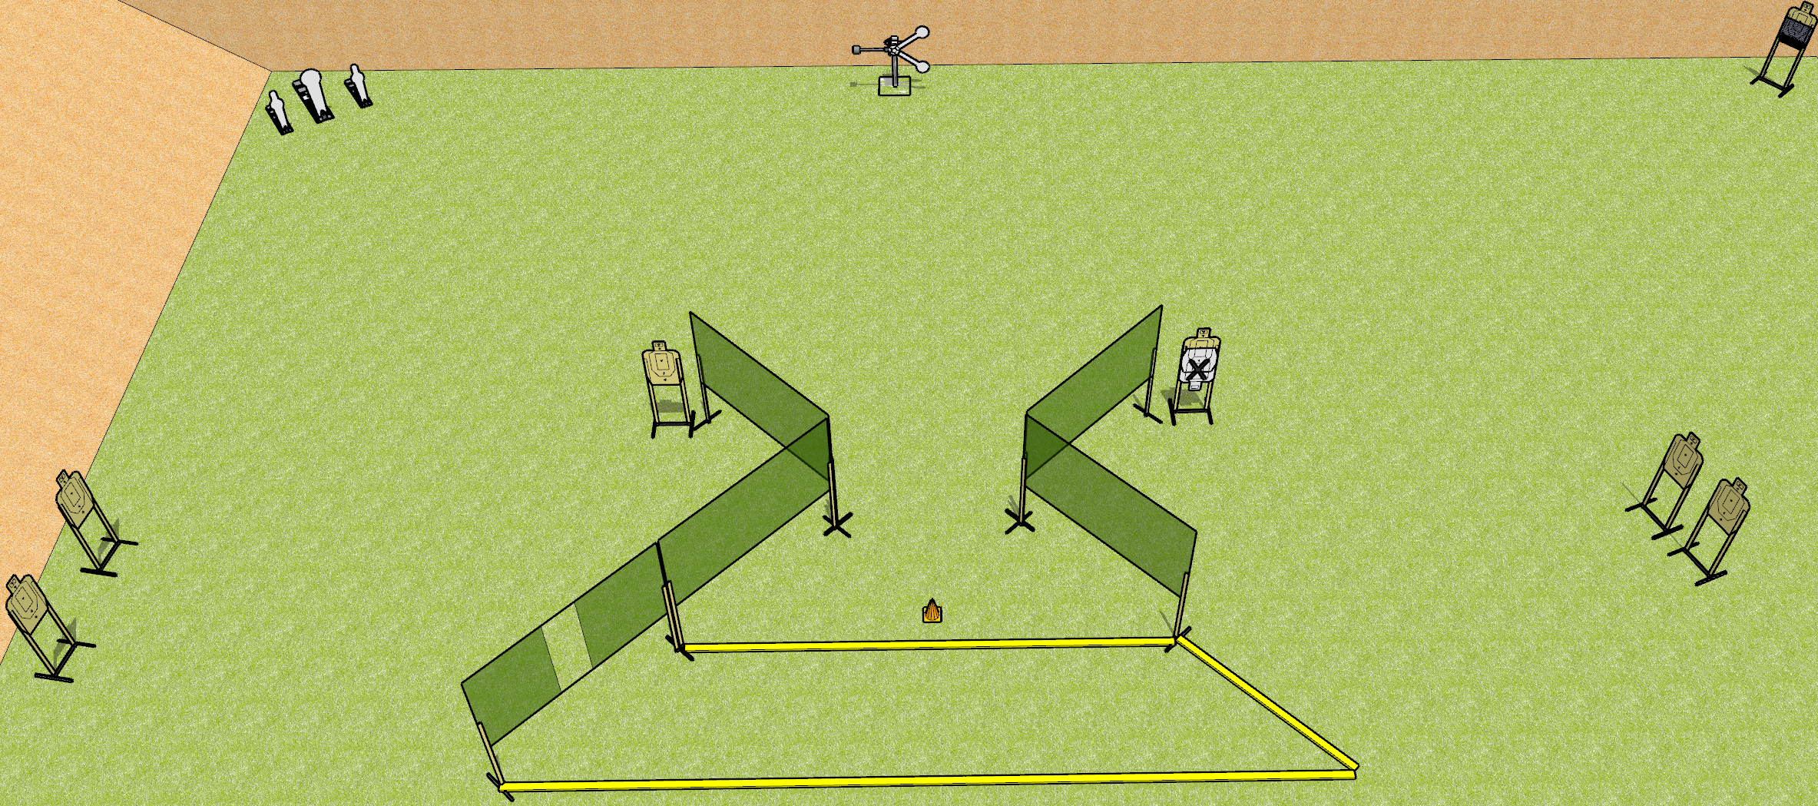
 | Dothan Gun Club – USPSA Match Far Far Away Course Designer : Drew Coleman
START POSITION : Outside the shooting area, toes touching rearmost fault line, wrists below belt
GUN READY CONDITION : Pistol loaded and holstered. PCC loaded, held with both hands, shouldered, safety on, pointed at orange cone. |  | SCORING: Comstock, 19 rounds TARGETS: 7 paper, 5 Steel SCORED HITS: Best 2 on paper, steel until down START-STOP: Audible, last shot RULES:
STAGE PROCEDURE: Engage targets as they become available from within the fault lines.

Slide 4
Far Far Away
Written Stage Briefing
Far Far Away is a 19 round, 95 point, Comstock medium course. There are 7 USPSA targets, 2 USPSA mini poppers, 2 falling plates, and 1 Colt popper. The best two hits on paper will score, and steel must fall to score. The start signal is audible.
The swinging plate target is activated by the rightmost mini popper, and must be activated before being engaged. Please check the activator prior to walkthrough and set it the same way every time. The target is not disappearing.
Handgun start position is toes touching rear fault line, wrists below belt. Handgun is loaded and holstered.
PCC start position is toes touching rear fault line, muzzle pointed at orange cone. Loaded carbine is held with both hands, shouldered, safety on.
On start signal, engage targets as they become available from within the shooting area.

Slide 5
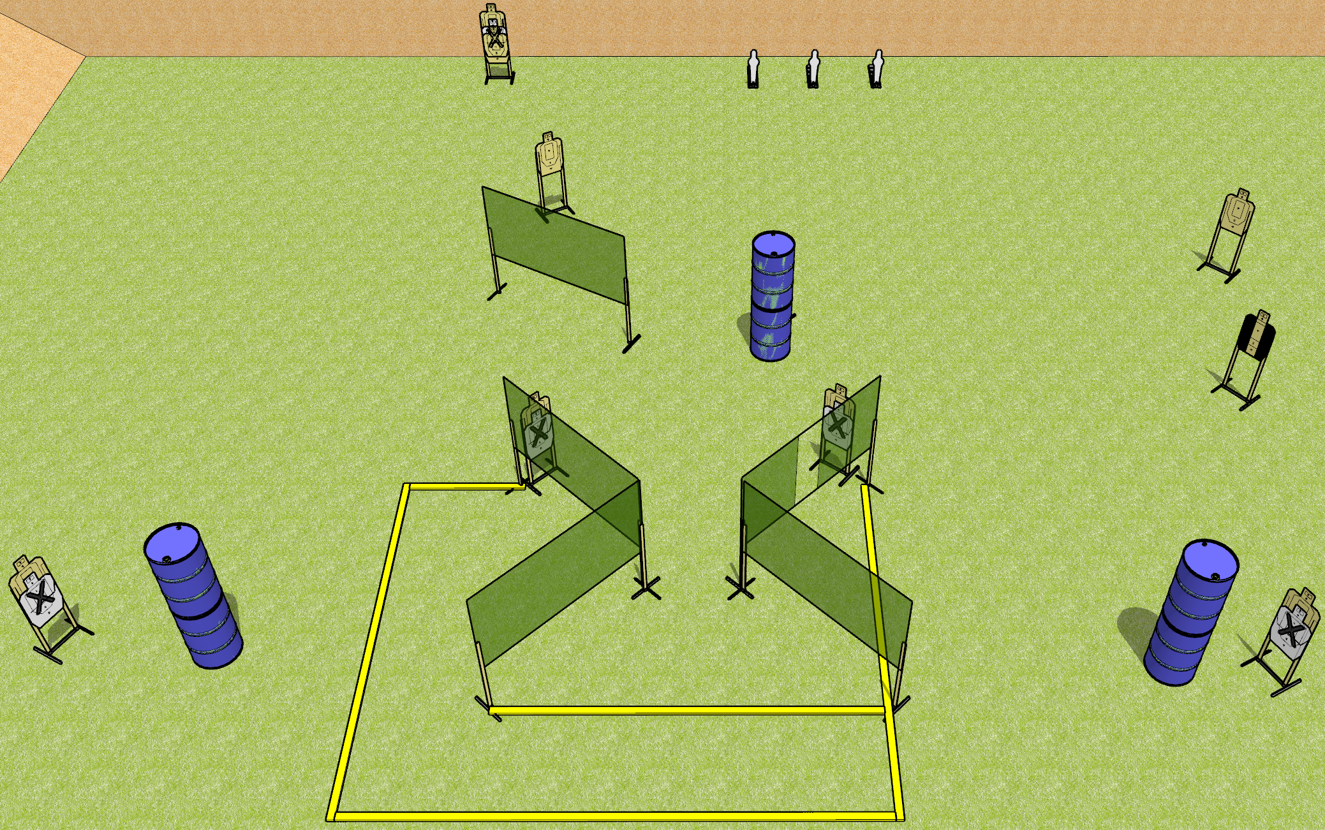
 | Dothan Gun Club – USPSA Match Bringing the Pain Course Designer : Drew Coleman
START POSITION : Standing anywhere inside the shooting area, wrists below belt
GUN READY CONDITION : Pistol loaded and holstered. PCC loaded, held with both hands, stock on belt, safety on. |  | SCORING: Comstock, 23 rounds TARGETS: 10 paper, 3 Steel SCORED HITS: Best 2 on paper, steel until down START-STOP: Audible, last shot RULES: (setup note: target with NS behind the center barrel)
STAGE PROCEDURE: Engage targets as they become available from within the fault lines.

Slide 6
Bringing the Pain
Written Stage Briefing
Bringing the Pain is a 23 round, 115 point, Comstock field course. There are 10 USPSA targets and 3 USPSA mini poppers. The best two hits on paper will score, and steel must fall to score. The start signal is audible.
Handgun start position is anywhere inside the shooting area, wrists below belt. Handgun is loaded and holstered.
PCC start position is anywhere inside the shooting area. Loaded carbine is held with both hands, stock on belt, safety on.
On start signal, engage targets as they become available from within the shooting area.

Slide 7
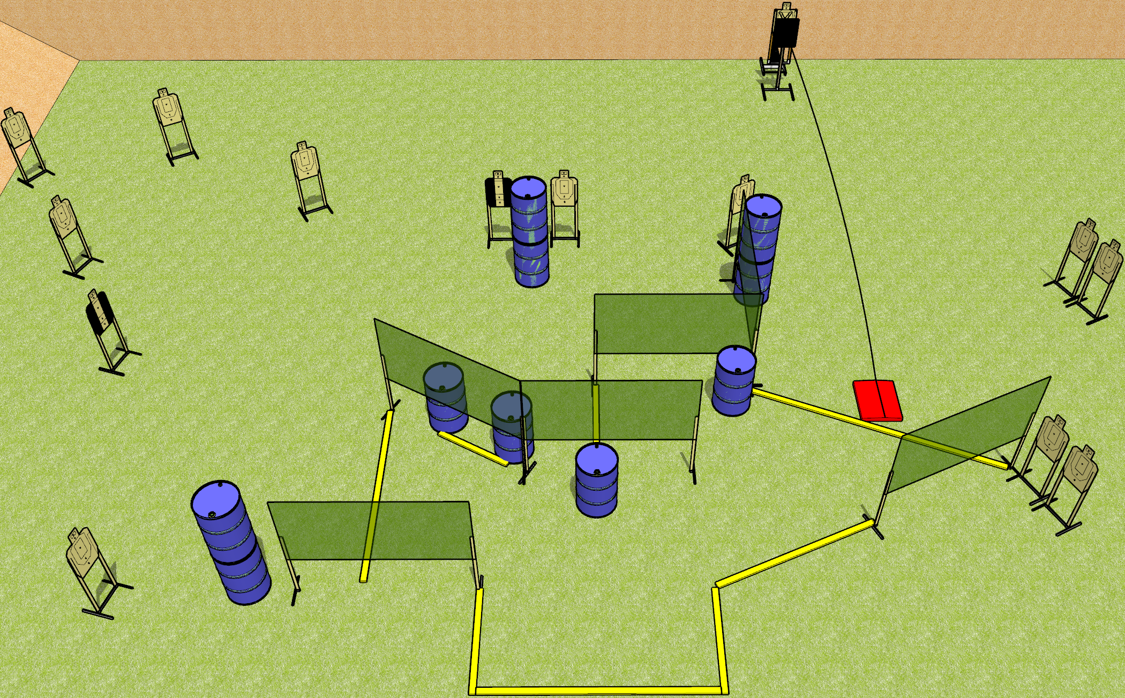
 | Dothan Gun Club – USPSA Match Hello Down There Course Designer : Drew Coleman
START POSITION : Standing with heels against rearmost fault line, wrists below belt
GUN READY CONDITION : Pistol loaded and holstered. PCC loaded, held with both hands, stock on belt, safety on. |  | SCORING: Comstock, 28 rounds TARGETS: 14 paper, 0 Steel SCORED HITS: Best 2 on paper, steel until down START-STOP: Audible, last shot RULES: Bobber must be activated before being engaged. The stomp box is part of the shooting area. The area with the barrels and fault line under the wall is considered a port.
STAGE PROCEDURE: Engage targets as they become available from within the fault lines. All magazines to be used for reloading must come from barrels inside the shooting area.

Slide 8
Hello Down There
Written Stage Briefing
Hello Down There is a 28 round, 140 point, Comstock field course. There are 14 USPSA targets. The best two hits on paper will score. The start signal is audible.
The bobbing target is activated by the stomp box, and it must be activated before being engaged. The stomp box is part of the shooting area. Please check the activator prior to walkthrough, and set it the same way every time.
Handgun start position is inside the shooting area, heels touching rearmost fault line, wrists below belt. Handgun is loaded and holstered.
PCC start position is inside the shooting area, heels touching rearmost fault line. Loaded carbine is held with both hands, stock on belt, safety on.
All magazines to be used for reloading must come from barrels in the shooting area. The area with the barrels and the fault line under the wall is a port.
On start signal, engage targets as they become available from within the shooting area.

Slide 9
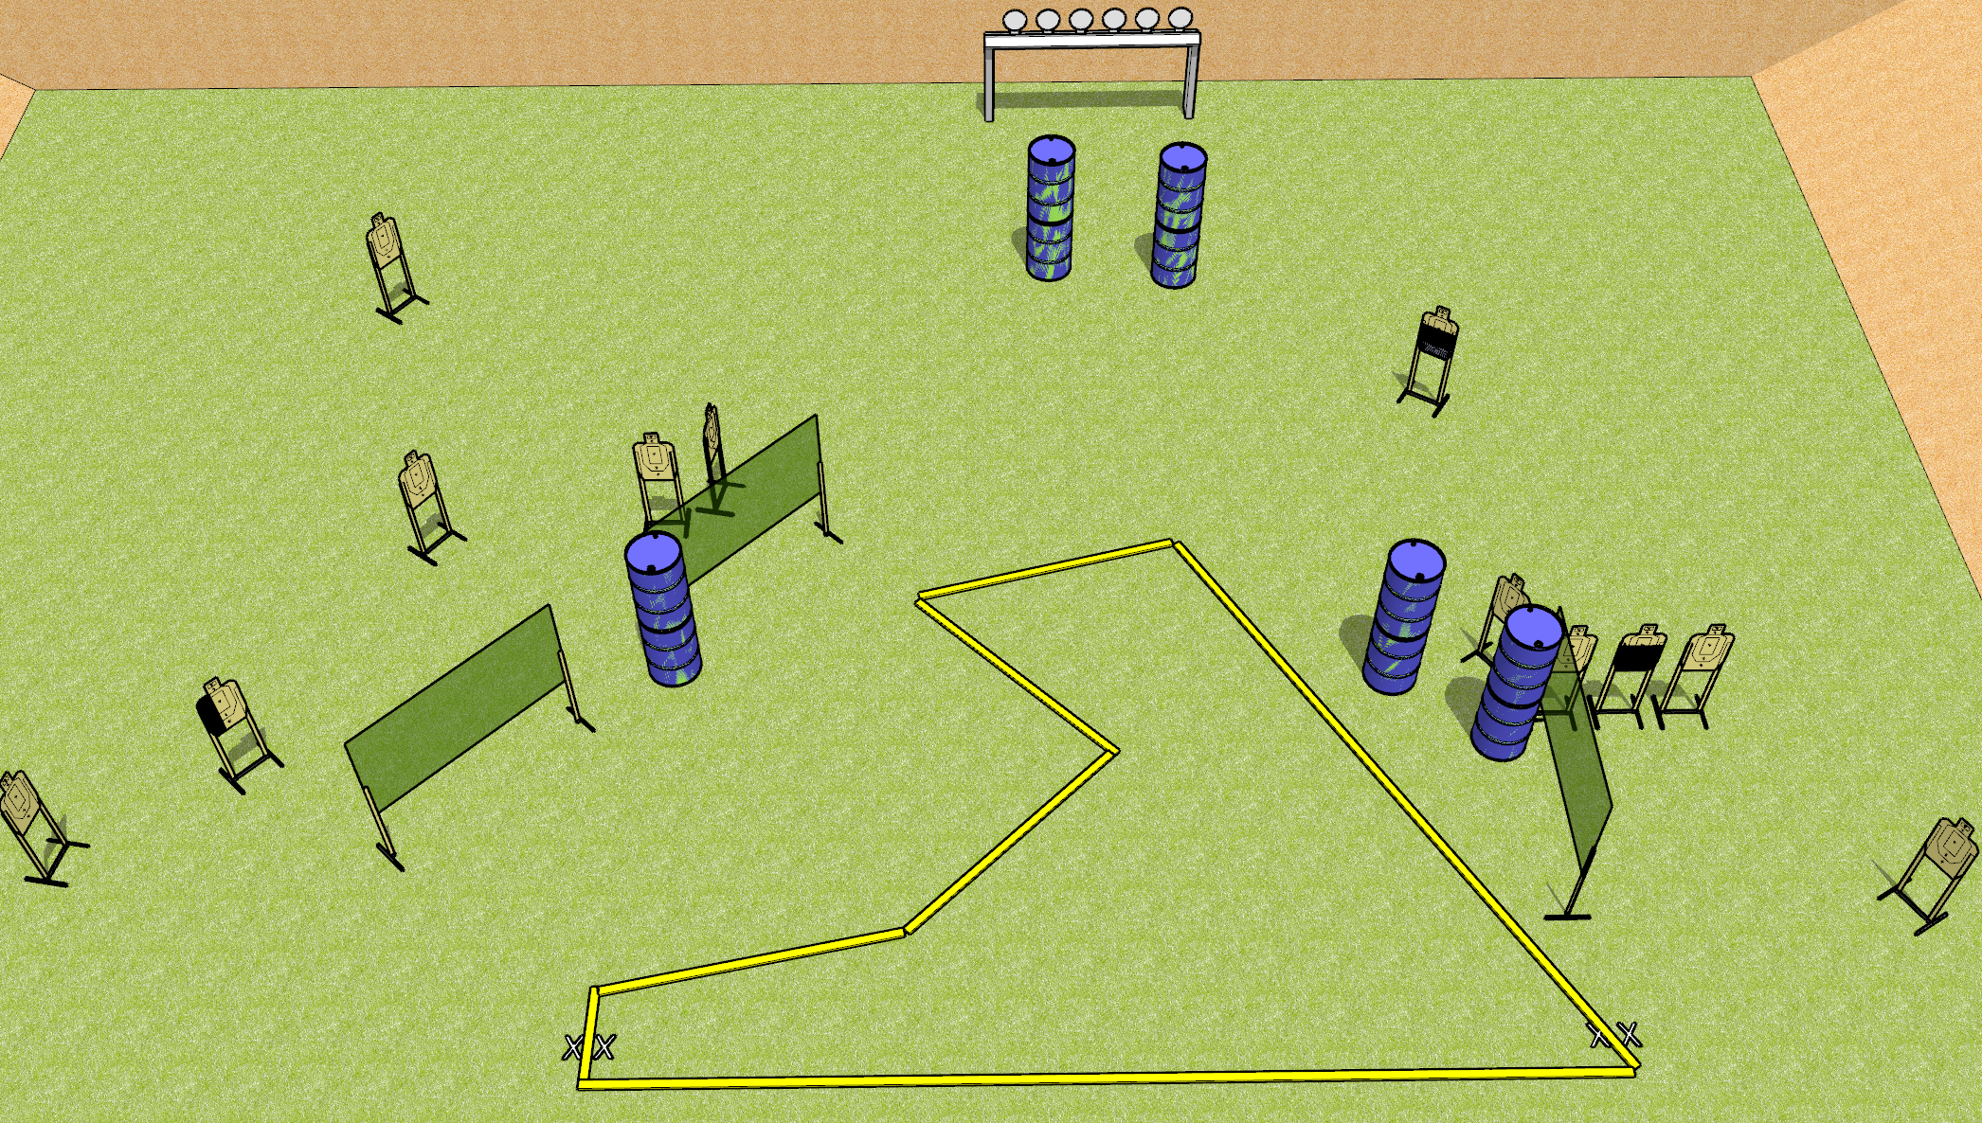
 | Dothan Gun Club – USPSA Match Shark Course Designer : Drew Coleman
START POSITION : Standing with both feet on either set of X’s, wrists below belt
GUN READY CONDITION : Pistol loaded and holstered. PCC loaded, held with both hands, stock on belt, safety on. |  | SCORING: Comstock, 30 rounds TARGETS: 12 paper, 6 Steel SCORED HITS: Best 2 on paper, steel until down START-STOP: Audible, last shot RULES:
STAGE PROCEDURE: Engage targets as they become available from within the fault lines.

Slide 10
Shark
Written Stage Briefing
Shark is a 30 round, 150 point, Comstock field course. There are 12 USPSA targets and 6 falling plates. The best two hits on paper will score, and steel must fall to score. The start signal is audible.
Handgun start position is both feet on either set of X’s, wrists below belt. Handgun is loaded and holstered.
PCC start position is both feet on either set of X’s. Loaded carbine is held with both hands, stock on belt, safety on.
On start signal, engage targets as they become available from within the shooting area.

Slide 11
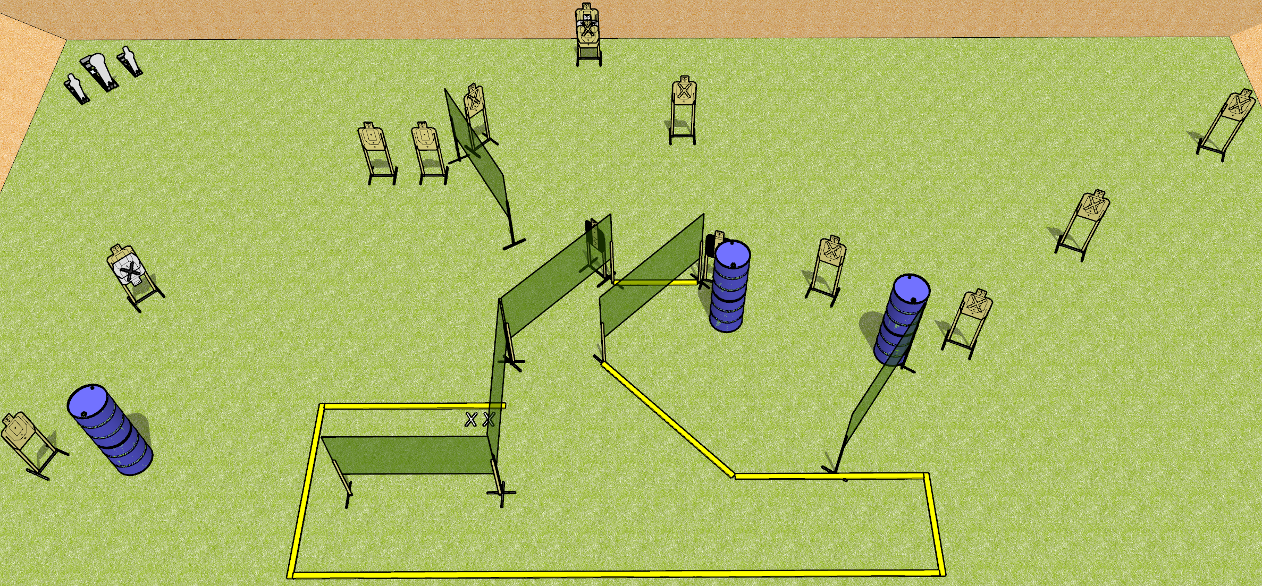
 | Dothan Gun Club – USPSA Match Something Something Course Designer : Drew Coleman
START POSITION : Standing with both feet on X’s, wrists below belt
GUN READY CONDITION : Pistol loaded and holstered. PCC loaded, held with both hands, shouldered, safety on, pointed at orange cone. |  | SCORING: Comstock, 31 rounds TARGETS: 14 paper, 3 Steel SCORED HITS: Best 2 on paper, steel until down START-STOP: Audible, last shot RULES:
STAGE PROCEDURE: Engage targets as they become available from within the fault lines.

Slide 12
Something Something
Written Stage Briefing
Something Something is a 31 round, 155 point, Comstock field course. There are 14 USPSA targets, 2 USPSA mini poppers, and 1 Colt popper. The best two hits on paper will score, and steel must fall to score. The start signal is audible
Handgun start position is both feet on X’s, wrists below belt. Handgun is loaded and holstered.
PCC start position is both feet on X’s, muzzle pointed at orange cone. Loaded carbine is held with both hands, shouldered, safety on.
On start signal, engage targets as they become available from within the shooting area.

